Slide 1

Team Axis
Notes:
Josh/Jude

Slide 2
Meet the Team
Leandro Dos Santos
Albertus Petrus Louw
As. Artist
Ld. Artist
Game Designer
Level Designer
Joshua Brian Miller-Pio
Jude Isaiah Cooksey
Ld. Developer
Developer
Game Designer
Designer
Team Lead
Notes:
Josh/Jude - Introduce all members one-by-one

Slide 3
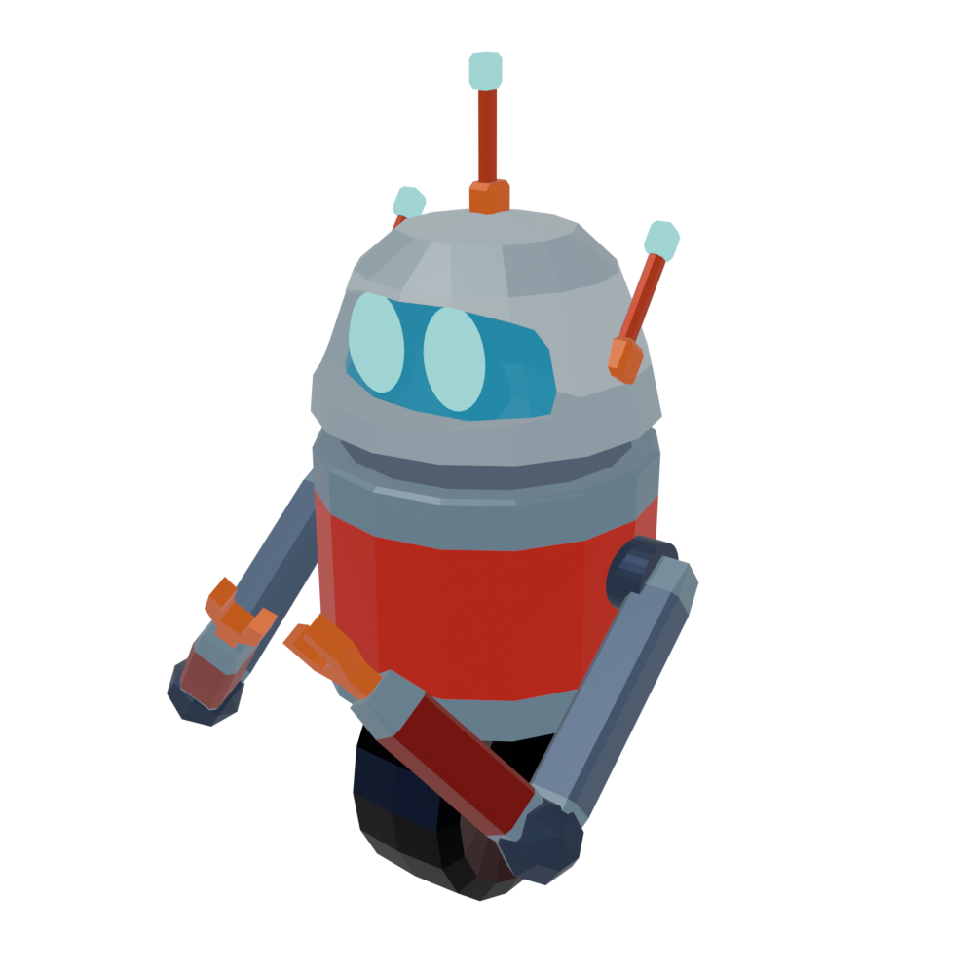
RATT-Bot
Notes:
Josh/Jude - Introduce Name of the Game

Slide 4
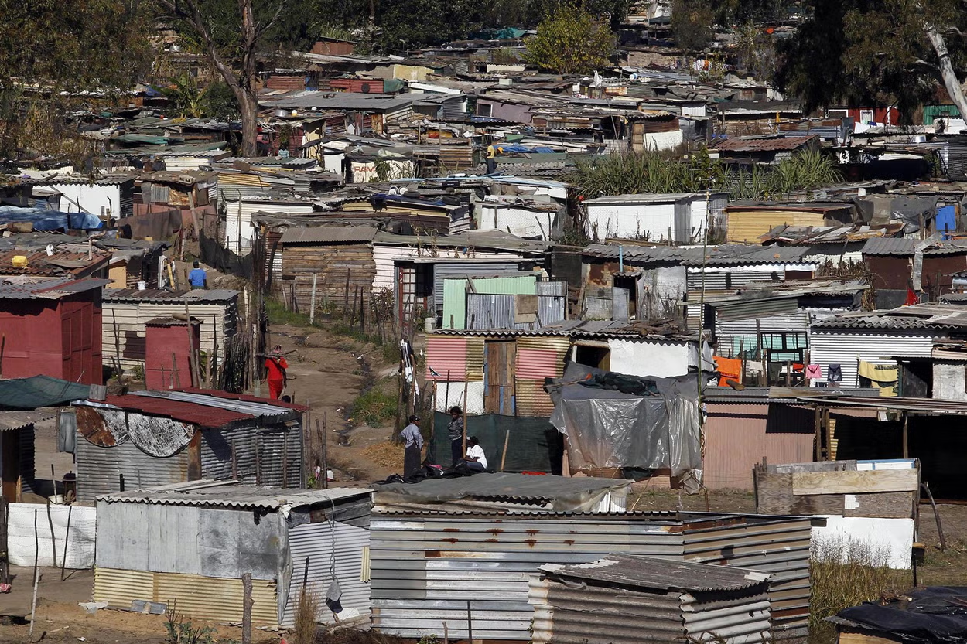
Social Issue
Target Audience
Disadvantaged communities of Townships
Poor Health & Living Conditions
Highlighted by Rat infestations
People between 14-16 and older
Young students
Explorers
Desktop and Mobile users
Notes:
Josh/Jude & Albert
Albert: Our target audience primarily includes young people aged 14 to 16, though we also reach older audiences. We’re focused on engaging students and explorers who are motivated to explore and learn. Our approach caters to both desktop and mobile users, making our content accessible wherever they are, whether they’re studying on the go or working from home.

Slide 5
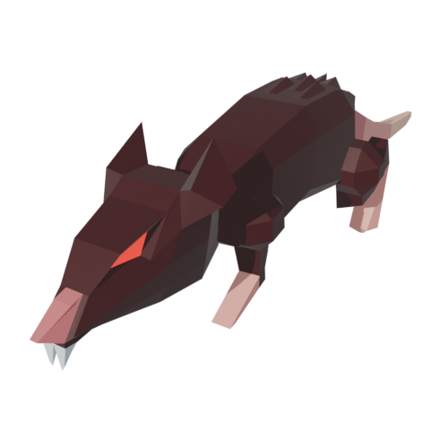
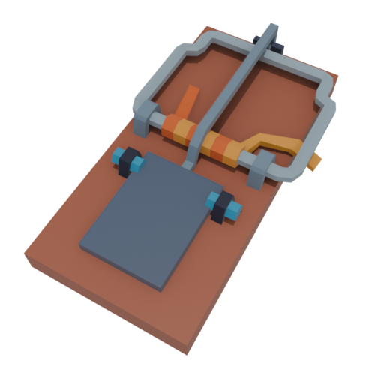
Game Synopsis
Take control of a homemade robot
Control it around the house by moving and dashing
Dodge environment objects
Pick-up rat traps found laying around the house
Use the traps to defend your house from the rats
Rats appear from holes within the house at random times
Stay alive!
Notes:
Josh/Jude
To Add:
Render of RATT-Bot and Rats

Slide 6
The Story
The Characters
A young inventor in a South African township
Creates RATT-Bot from recycled parts, scrap metal
Uses the robot to defend her family and house from the rats
Uses her creation in a science fair showcase
Grace
The Rats
RaTT-Bot
Notes:
Albert & Leandro
Add Level1_P1 and Level2_P3 panels to this page
Albert: Our story centers on a young inventor from a South African township. She builds a robot from everyday objects she finds around her home. This robot becomes her defender, protecting her family and home from the rats that threaten them. Her creation also becomes her pride and joy as she showcases it in a local science fair, demonstrating her ingenuity and resilience.

Slide 7
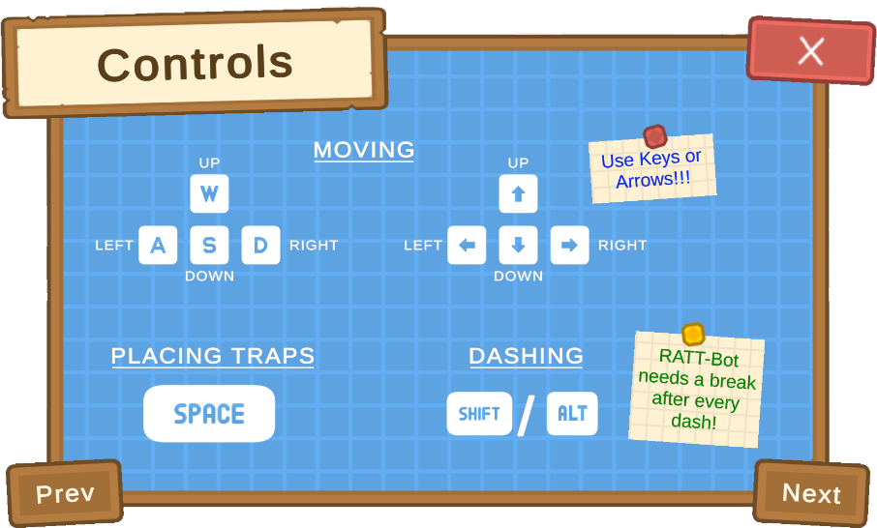
RATT-Bot
Control the bot around the environment
Dodge furniture and house items
Pickup up rat traps using its arms
Throw traps around to damage the rats
Dash to avoid the traps yourself
Defend the family and house
Notes:
Josh/Jude

Slide 8
The Rats
They appear from the holes on the walls
Mean and aggressive
Aim for the object
Defeat them with rat traps
Notes:
Leandro
Maybe add screenshot of what the objective looks like

Slide 9
The Traps
They appear around the house randomly
Can be picked up by the robot created by Grace
When picked up can be thrown around the house
Can slow the player if not dashed over
Lasts a certain amount of time
Notes:
Albert

Slide 10
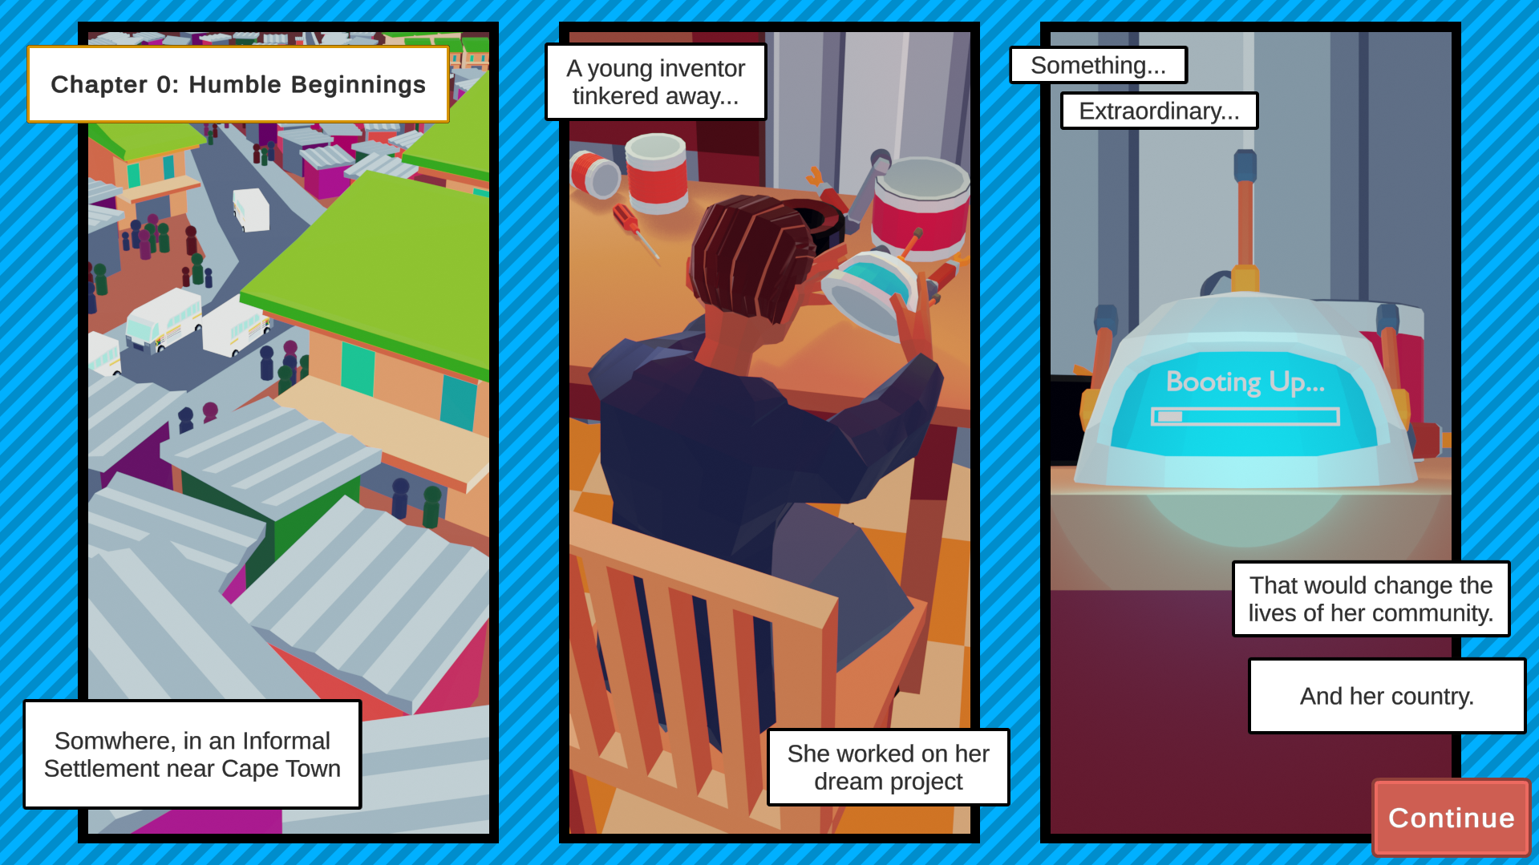
Storytelling System
Comic Panels
Level Design
Notes:
Josh/Jude
Just cover that comics were chosen for the young age audience
Easy to visually explore the environment of townships
Much more engaging than boxes of text
& Leandro
Comic appears before a level starts (Except for the conclusion comic, which plays at the end of the game)
Each panel appears one-by-one with a few seconds gap between
Each panel has text boxes to explain story
Comic cannot be skipped to force player to engage with Story

Slide 11
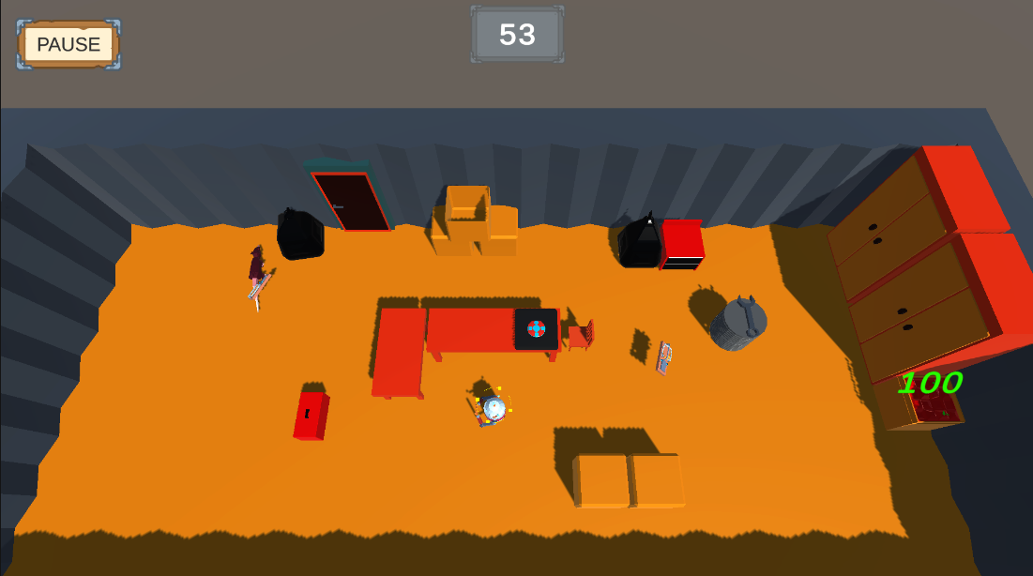
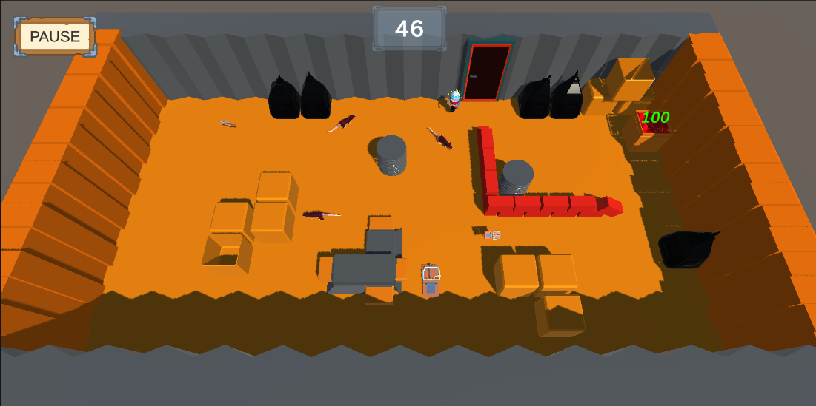
Game
Screenshots
Notes:
Albert

Slide 12
Thank you!
(Any Questions?)
Notes:
Josh/Jude

Slide 13
Image References
Cooksey, JIC. 2024. Axis Logo. Cape Town: Unpublished.
Greenwood, XG. 2018. A shanty-town on the outskirts of Johannesburg. [Online] Available at:
https://www.independent.co.uk/news/world/africa/south-africa-unequal-country-poverty-legacy-apartheid-world-bank-a8288986.html [Accessed 7 November 2024].
Cooksey, JIC. 2024. 3D RaTT Bot model. Cape Town: Unpublished.
Albert, APL. 2024. RaTT Bot Controls. Cape Town: Unpublished.
Cooksey, JIC. 2024. 3D Rat Model. Cape Town: Unpublished.
Cooksey, JIC. 2024. 3D Rat Trap Model. Cape Town: Unpublished.
Cooksey, JIC. 2024. Tutorial Level Comic Set. Cape Town: Unpublished.
Dos Santos, LDS. 2024. First Level Screenshot. Cape Town: Unpublished.
Dos Santos, LDS. 2024. Second Level Screenshot. Cape Town: Unpublished.

